Slide 1
Bayesian Neural network
Peng Wu
Blundell, Charles, et al. "Weight uncertainty in neural networks." arXiv preprint arXiv:1505.05424 (2015).
Notes:
Hi everyone, today I am going to talk about bayesian Neural network. This is based on the paper: Weight uncertainty in neural network, from the google deep mind.
I am new to this topic, so forgive me if the example is easy to you.
Hi, everyone, I am also talk about Bayesian Neural network, it’s bad luck when you find someone has the same topic with you. And more worse is that you find his talk more deep than you. So forgive me for some same content and some simple result as I also new to this topic.

Slide 2
Outline
What is Bayesian Neural network
Probabilistic Model
Variational Inference
Network training
-- Re-parameterization
-- Back propagation
Implementation example
Reference
Notes:
This is the the outline?
First will give you a hint about what is bayesian neural network
Second review the probabilistic model we have learned before
Then, will talk about the variational inference.
Network training, re-parameterization trick will talk and back propagation.
Last, we will see the implementation example.

Slide 3
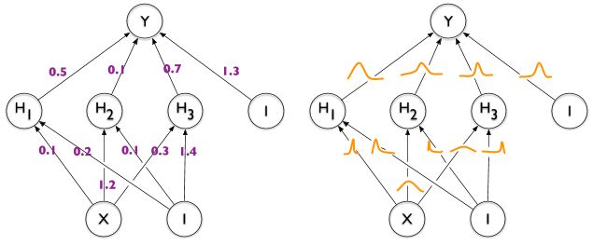
What is Bayesian Neural network?
Notes:
What is Bayesian Neural network. Just as this figure show, the left is standard neural network.
We will learning the weight, the value return to us is a fixed number. Instead, the bayesian neural network will give us the distribution of the weight.
And then the distribution can be used to estimate the distribution of prediction.

Slide 4
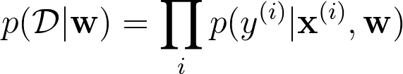
Probabilistic model
MLE: Given a training dataset D= (x^i,y^i), construct the likelihood function
MAP: Given a training dataset D= (x^i,y^i), introduce prior distribution
Notes:
Let’s first review the probabilistic model we have learned. What is the difference between MLE MAP and bayesian inference: the most different is MLE and MAP are point estimator, only return a fixed weight.
For MLE, given a training dataset D, construct the likelihood function, maximize the likelihood function give the maximum likelihood estimate of w.
For MAP, multiple the likelihood with prior distribution P(w), By bayesian theory, which is proportional to the posterior distribution. Maximize the P(D|w) P(w) will get the maximum posterior estimate of w. Computing the MAP estimate has a regularizing effect and can prevent overfitting.
Both MLE and MAP is point estimate of parameters, if we get a full posterior distribution over parameters, the we can make a prediction that take weight uncertainty into account.

Slide 5
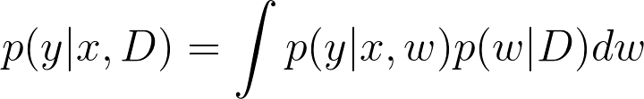
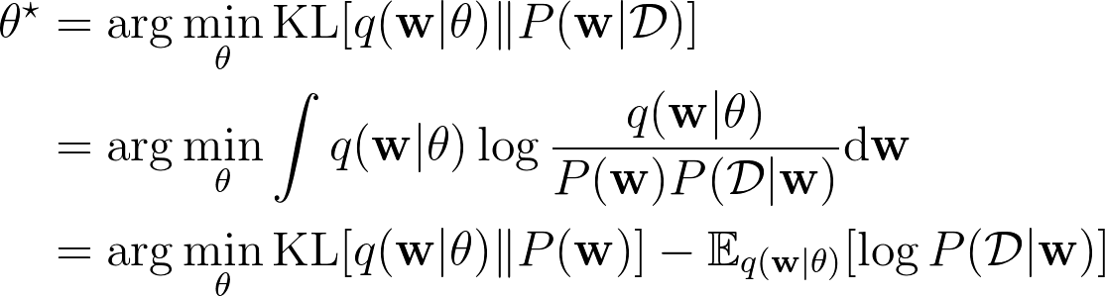
Variational inference
Intractable:
Large dimension
Complex form of posterior distribution
Notes:
This is shown as this formula. Unfortunately, an analytical solution for the posterior p(w|D) p(w|D) in neural networks is untractable
This maybe due to the large dimension of the latent parameters or the complex form of the posterior distribution.
Thus, we therefore use a weight distribution q(w) to approximate the true weight distribution. This can be done by minimizing the KL divergence of q(w) and p(w|D). This method is called variation inference.
And then derive as follow. This become a cost function, the to minimize it, we can get the weight.

Slide 6
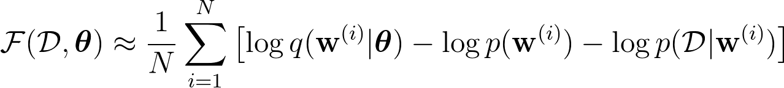
Variational inference
Cost function:
Notes:
The cost function then can be wrote in this form, The first term is KL divergence of q(w) and p(w), called complixeity cost, the second term is likelihood.
By rearrange the KL term, we can get the formula. The three terms are all the expectation of q(w).
That means we can draw samples from the q(w) to approximate the cost function as this form.

Slide 7
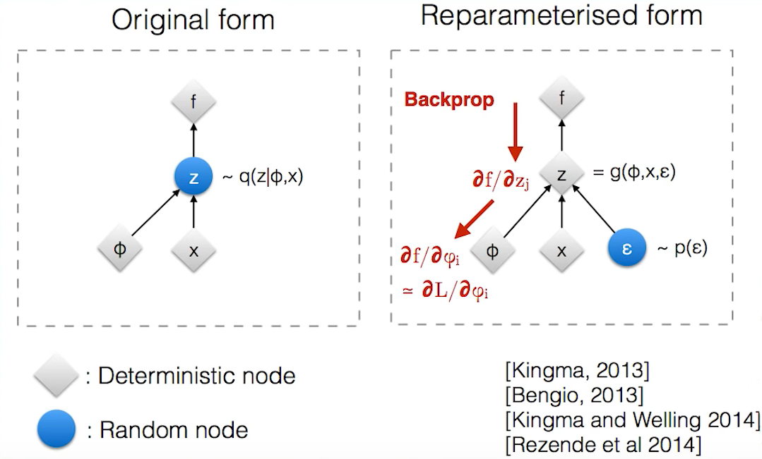



Network training
Forward-pass: Draw sample from the variational posterior distribution
Backward-pass: Evaluate cost function, take gradient w~N(u,σ)
Re-parameterize trick:
Where
Notes:
Now we have the cost function, we need to train.
It has two step. Forward-pass. We will draw sample from the variational posterior distribution.
And backward-pass, the gradient of parameter need to be calculate. Here we assume the weight has a gaussian distribution (u, sigma).
But, we need a trick call re-parameterization trick for backpropagation to work.
Gradient can’t derive under random parameter, it must be deterministic. As the figure shown, we transform the random node into deterministic by add a new parameter \epsilon, where epsilon is normal distribution. Here, we will take the gradient of sigma, which will we introduce a new paramter rho to ensure the the sigma is big than 0.
Then the weight can be shown as the formula: w = u+log(1+exp(p)) times the epsilon.

Slide 8

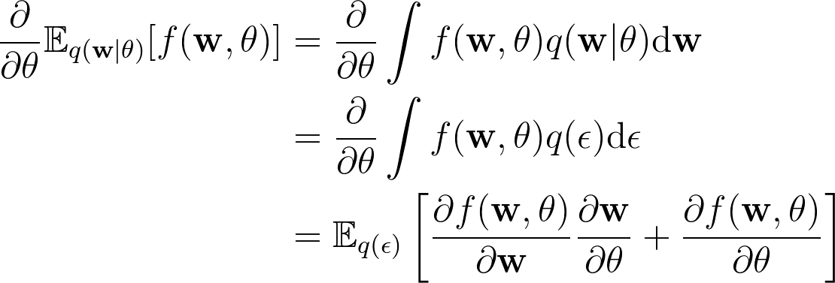
Back Propagation
Proof:
Notes:
For the back progagation, as this formula shown, q(epsilon)depsilon = q(w)dw
Take the gradient will equal to expectation of q(epsilon) times derivative or w times w over theta, + costfunction over theta.
This is the proof.

Slide 9
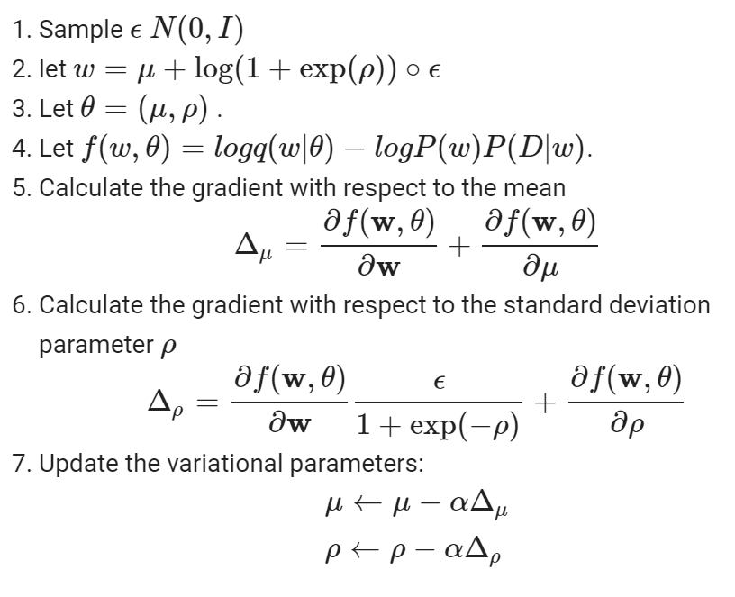
Step by step
Notes:
Then this is step by step implemetation:
1,draw sample form
2, let w =
3, Then we have the theta,
4, this is the loss function
5, calculate the gradient with repect to the mean,
6, calculate the gradient with respect to the stanard deviation parameter rho
7, then update the weight.

Slide 10
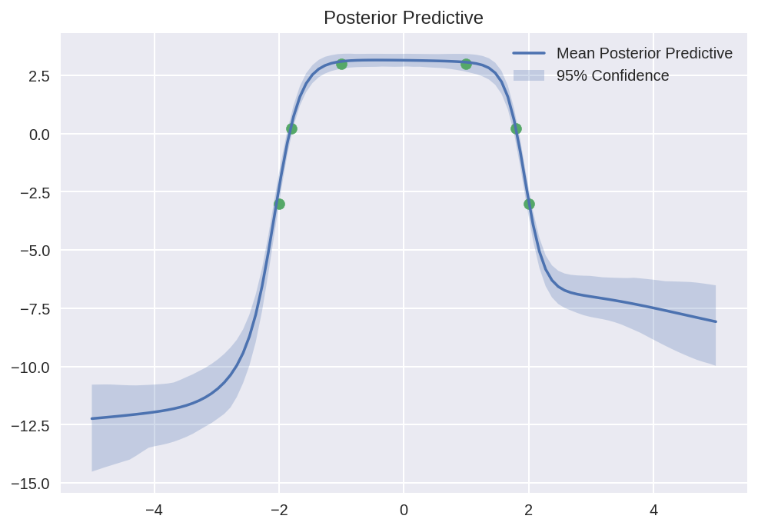

Implementation

Slide 11
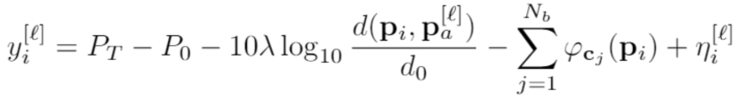
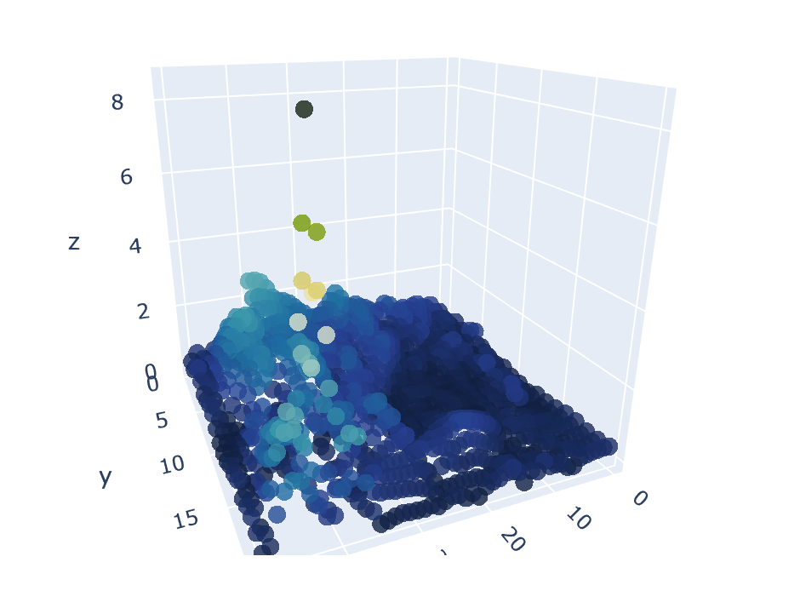
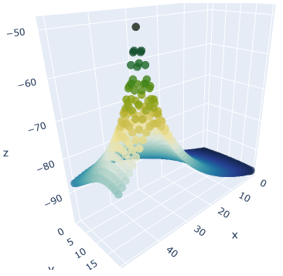

Path Loss model
Notes:
After this simple model. Let’s try a little complex one.
Path loss model is a signal transport model used in my project. Use the function, we simulate the Signal strength value called RSS value based on distance between location and trainmit node.
Then given a location, we want to estimate the signal value.
The left figure shown the training data filed. The right figure show the absolute value of predict error. Always the location close to the transmit node, has the biggest error prediction.
Even though I know this is training error, I still confused why I can’t have a kind of perfect simulation as other area. If I create a big neural network, don’t care about overfitting, can I get a perfect simulation?

Slide 12
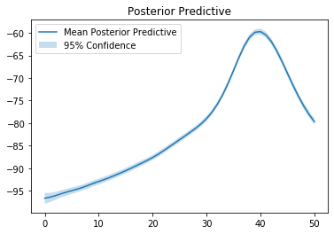
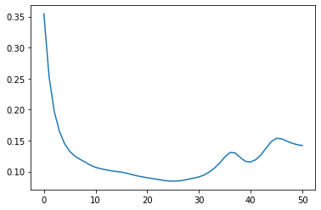
Implementation
X
X
Notes:
Anyway, let’s see the prediction using the bayesian neural network. The left shown one dimension of location with the signal. Because it’s difficult to show two dimension of confidence.
To make it more clear, I calculate the variance for every location shown in right figure.
We can see in the edge, few data was trained. Thus the variance is a little big than middle area.

Slide 13
Questions
The location that have large error prediction should have large variance, but why is not this situation?
How to train a neural network that can approximate the simulated function perfectly?
….

Slide 14
Reference
https://github.com/cpark321/uncertainty-deep-learning
https://joshfeldman.net/ml/2018/12/17/WeightUncertainty.html
http://krasserm.github.io/2019/03/14/bayesian-neural-networks/
https://github.com/krasserm/bayesian-machine-learning
https://github.com/JavierAntoran/Bayesian-Neural-Networks
https://github.com/nitarshan/bayes-by-backprop/blob/master/Weight%20Uncertainty%20in%20Neural%20Networks.ipynb
https://paperswithcode.com/paper/weight-uncertainty-in-neural-networks
https://github.com/anassinator/bnn

